Slide 1
Receipt Keeper
PROG 8220
C. Choi, H. Nahhal, N. Collins, S. Kim

Slide 2
Introduction
`
http://netsecurity.about.com/od/advancedsecurity/a/How-To-Stay-Safe-On-Craigslist.htm
http://blog.spacesavers.com/5-tips-for-organizing-receipts-for-taxes/
http://www.shoeboxservices.ca/resources/

Slide 3
Outline
Problem
Solution
Technologies used
Methodologies
Technical diagrams
Screenshots
Future
Conclusion

Slide 4
Problem
Waste of time
Forget stuff bought
Strict Budget
Household with one income source
Business with many buyers and one account
Current solutions are not ultimate
55,000 receipts can spare an entire tree
680388 ton of waste

Slide 5
Solution
Use of Optical Character Recognition
Filter receipts
Search for receipt
Generate reports
Group account for multiple users
View spending
Export data as files
View data on web and mobile
Notes:
No tech word
Refactor to 7 or less line and words

Slide 6






Technologies Used
Scan
receipt
Output
data
Save in
database
Track
expenses
View
anywhere
Notes:
Flow of the app

Slide 7
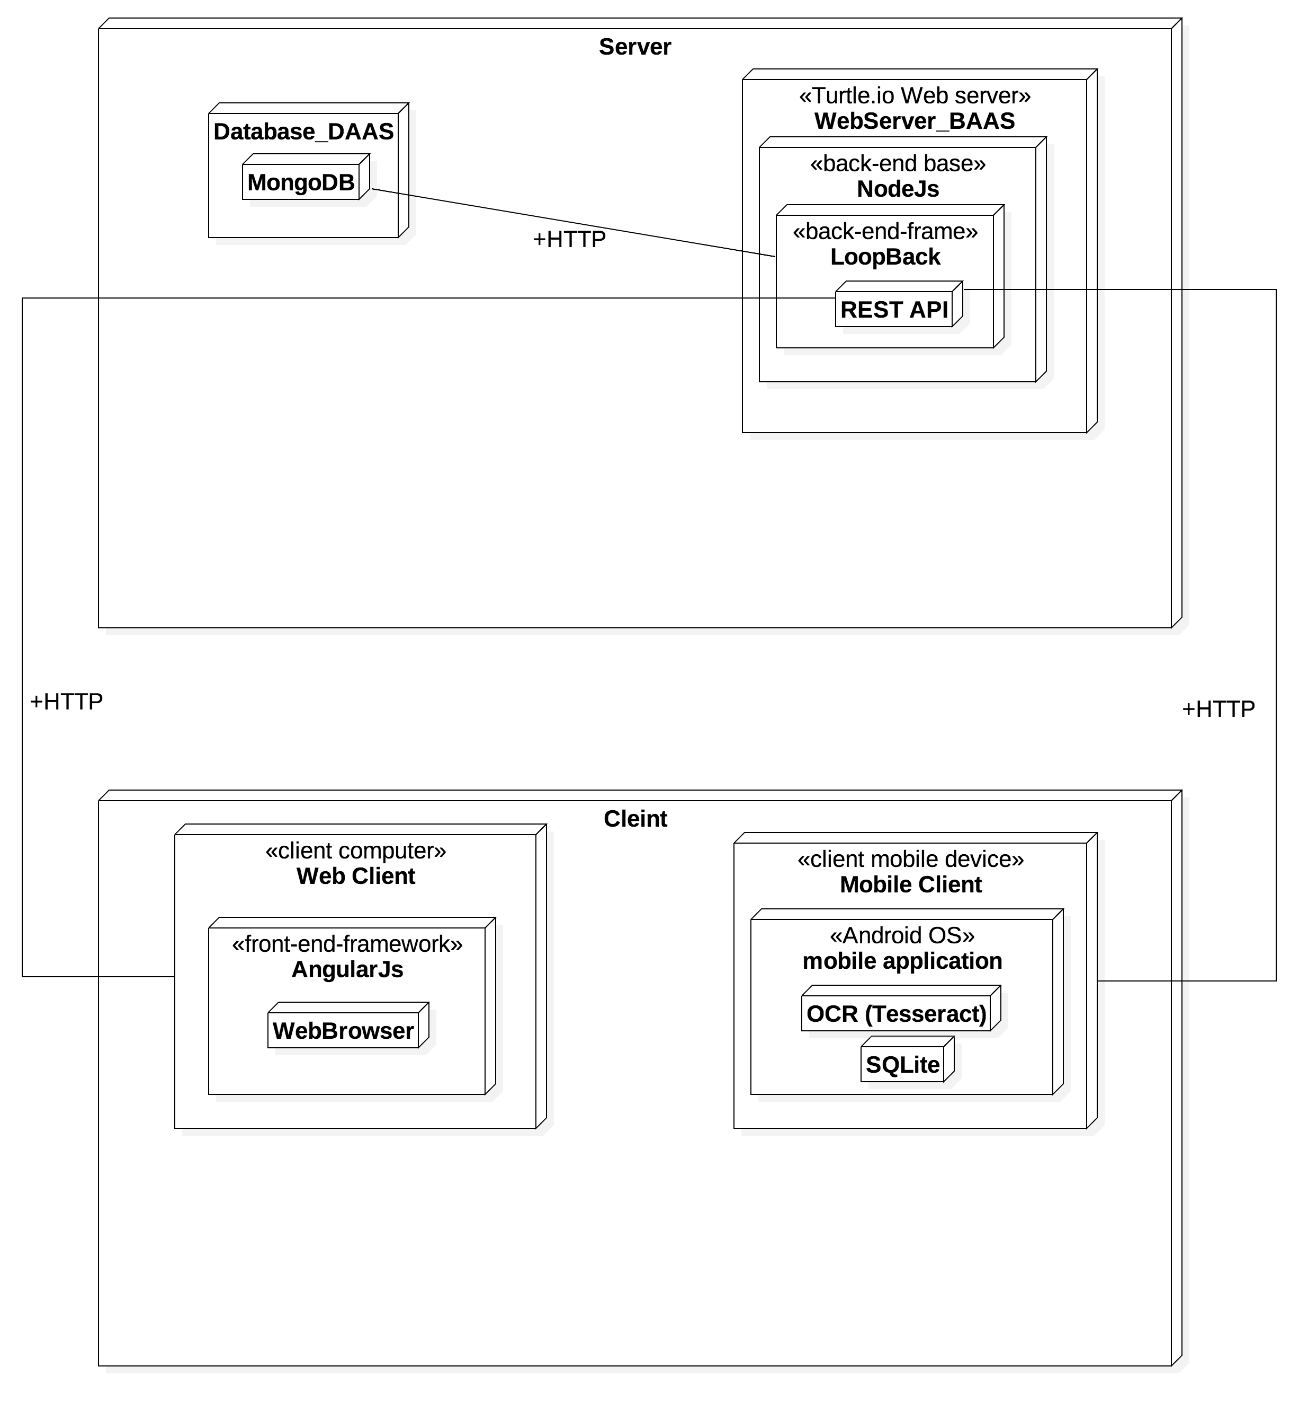














Technologies Used (Cont.)

Slide 8
Methodologies
TurtleIO hosts the web server
Web server is implemented using Node.js
LoopBack creates REST API for the server
Android mobile client using SQLite and Tesseract
Web client implemented using Angular.JS , HTML, CSS, Bootstrap, JavaScript, and jQuery
MongoLab stores data from the clients

Slide 9
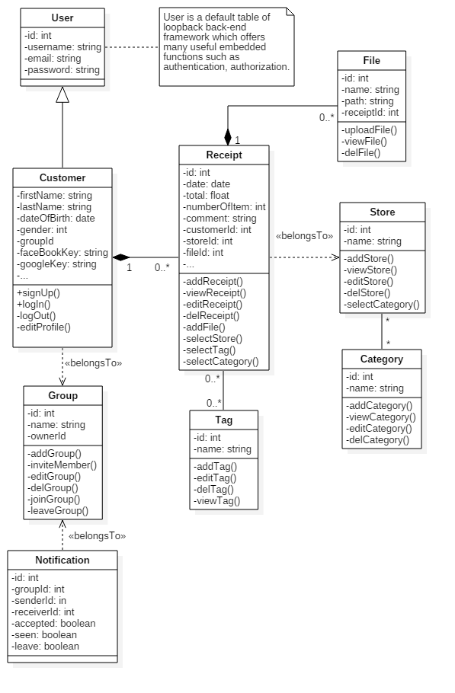
Technical Diagrams
Fig. Class Diagram

Slide 10
Screenshots

Slide 11
Future Plans
Save daily paperless receipts with single button
Import backup with different formats
Switch between accounts
Combine multiple images
Use OpenCV to increase accuracy
Track user spending in group accounts
Show specific item spending

Slide 12
Conclusion
Scan receipts with mobile
Save locally and online
Track spending
View and export reports
Receipt persistence anywhere anytime
Group account
Notes:
How we solved the problems

